Slide 1
BOOKSTORE MANAGEMENT SYSTEM
Submitted By :
Abdel Rahman Ayman Almasri
201910686

Slide 2
PROJECT PROFILE
Project Definition: Bookstore Management System
Project Duration: 2 Months
Objective: To Computerize all the Book Details,
Manage Easily Details, Sell Books.

Slide 3
SYSTEM ENVIRONMENT
Front End: HTML, CSS, BOOTSTRAP
Back End: PHP, MySQL
Tools & Technologies: Xampp Server,
MySQL Queries,
Browser (Chrome..)
IDE (PhpStorm 2023.2)
Diagrams (draw.io)

Slide 4
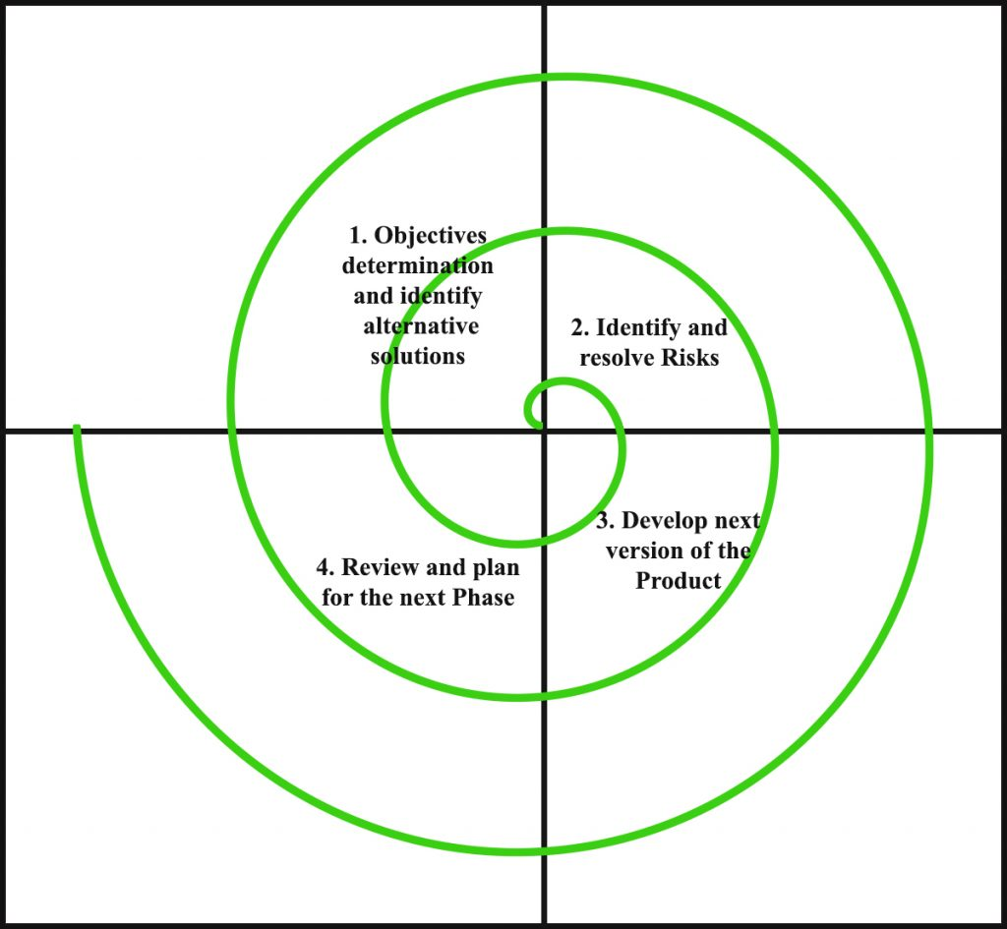
SYSTEM DEVELOPMENT STRATEGY
As per the requirement of the project, We have chosen Spiral as a strategy for developing the project, because in spiral-SDLC model starts with a small set of requirements and goes through each development phase for those sets of requirements, so the appropriate strategy is the spiral model.

Slide 5
SYSTEM DESIGN
USE CASE DIAGRAM
ACTIVITY DIAGRAM
E-R DIAGRAM
SCREENSHOTS
TESTING AND IMPLEMENTATION

Slide 6
USE CASE DIAGRAM
BOOKSTORE MANAGEMENT SYSTEM
View Books
Order
User
Login
Add to Cart
Admin
Register
Add Cat, Books
Visitor
Delete Cat, Books
Delete User

Slide 7
ACTIVITY DIAGRAM
Home Page
View Books
Select Book
Book Detail
Add to Cart
Is a Member
Login
No
Yes
Register
Added to Cart
Submit Order
Order Placed

Slide 8
E-R DIAGRAM
city
e-mail
password
con-no
name
date
id
Customers
Buys
id
name
name
image
id
price
BMS Contains
qty
Cart
Books
image
price
Cat..
Has Many
desc
Category
id
name

Slide 9
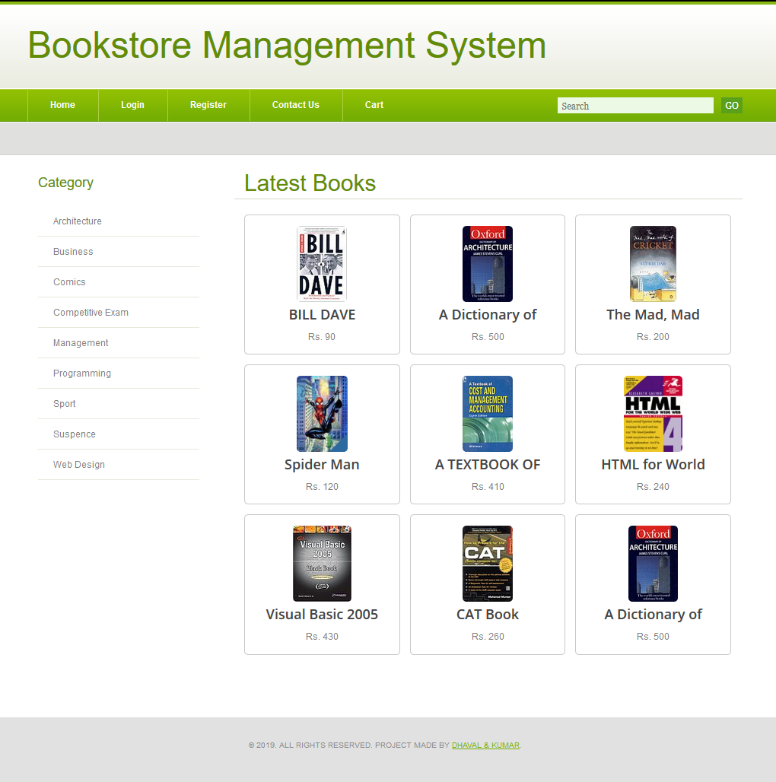
SCREENSHOTS
Home Page

Slide 10
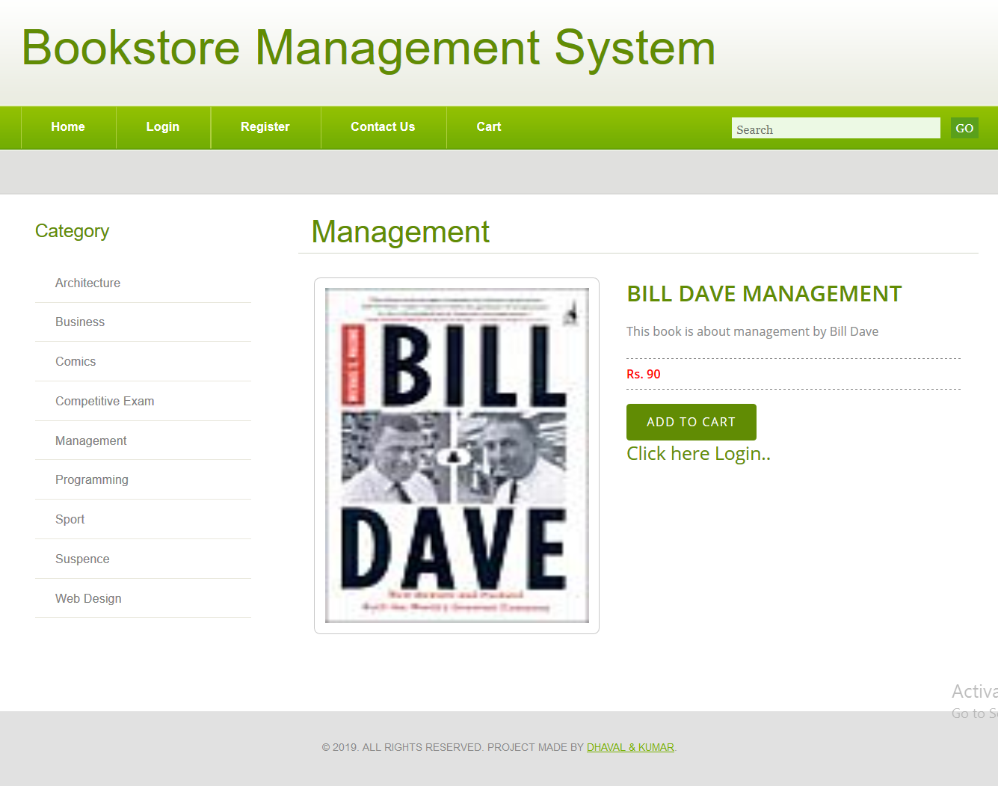
Book Detail
Login Required for Add To Cart

Slide 11
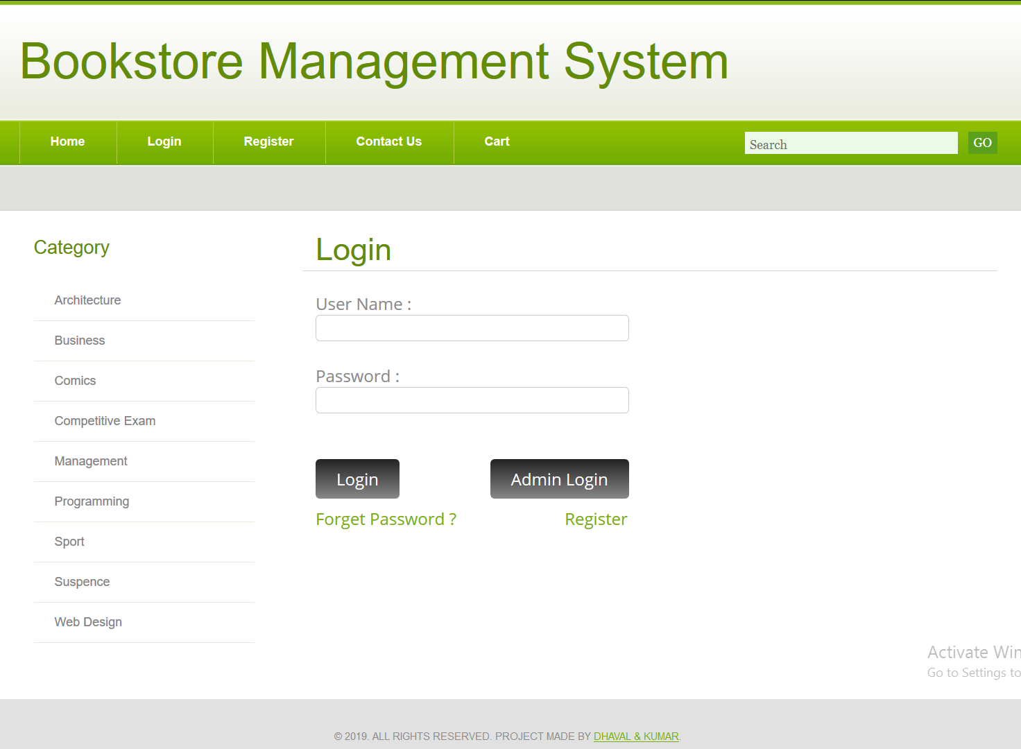
Login Form

Slide 12
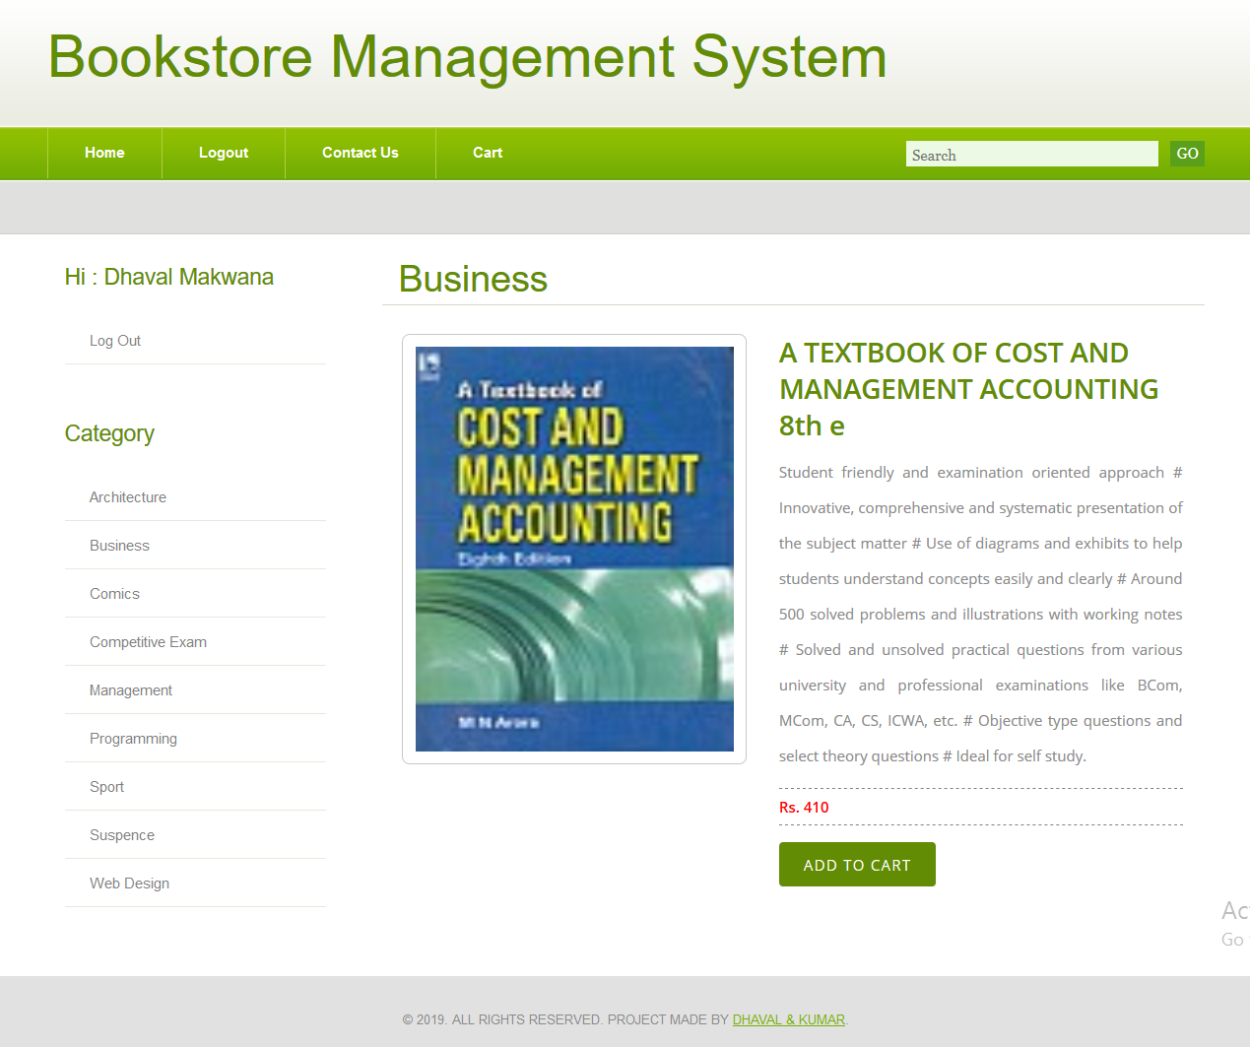
User Detail Page

Slide 13

TESTING AND IMPLEMENTATION
Gray Box Testing
Gray-box testing is a testing technique performed with limited information about the internal functionality of the system. Gray box testers have access to the detailed design information about requirements.
Gray box are generated based on the state based modes, UML diagrams or of the target system.
Gray Box Testing is a technique to test the software product or application with partial knowledge of the internal workings of an application.

Slide 14
Thank you

